Slide 1


Incident Command Trainings

Slide 2
It is suggested that the courses are taken in this order, these trainings are meant to build on each other.
  IS-100 – Introduction to Incident Command System
  IS-700 – National Incident Management System (NIMS)
  IS-200 – Basic Incident Command System for Initial Response
  IS-800 – National Response Framework, An Introduction
  G-606 – Standard Emergency Management System

Slide 3
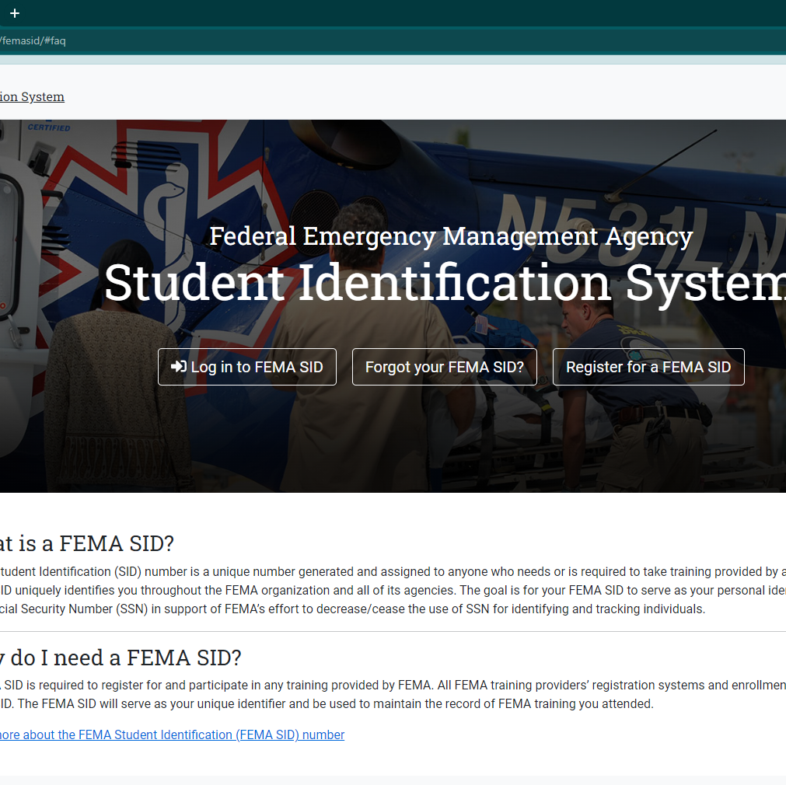
A FEMA SID is required to register and participate in any training provided by FEMA. The FEMA SID will serve as your unique identifier and be used to maintain the record of FEMA training you attended.
If you do not yet have a SID, register here https://cdp.dhs.gov/femasid/#faq.

Slide 4
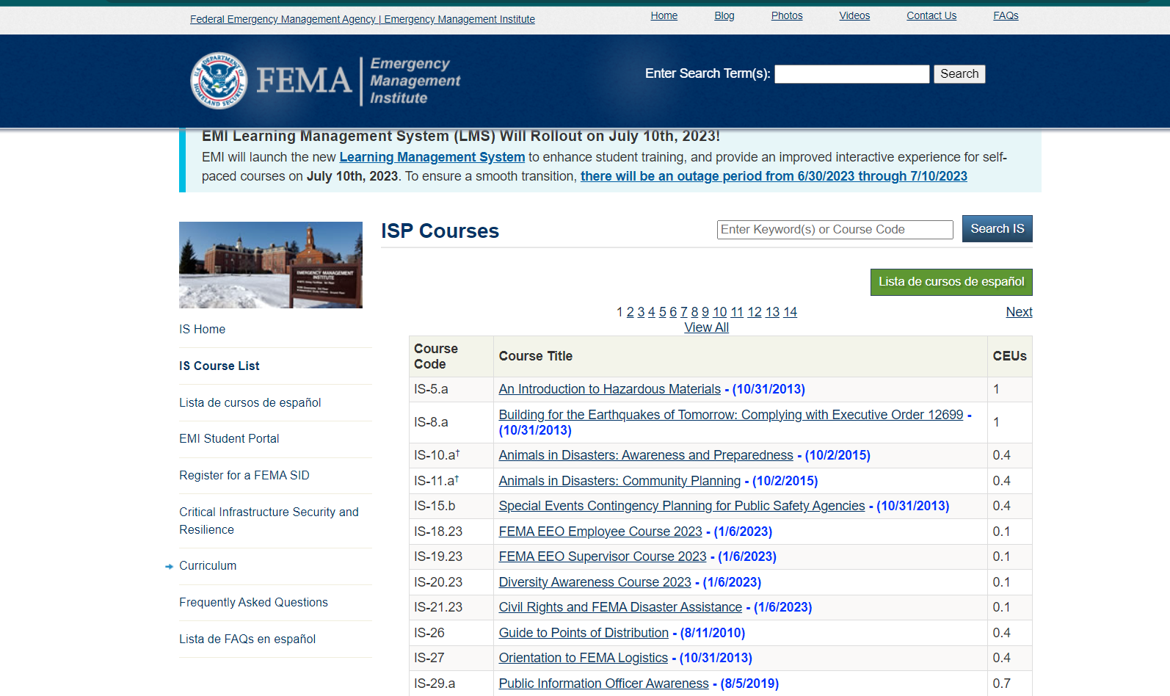
The best link for the FEMA trainings (IS-100, 200, 700, 800) is
https://training.fema.gov/is/
If you choose the IS course list it will list all the classes available, you can then search for your trainings

Slide 5
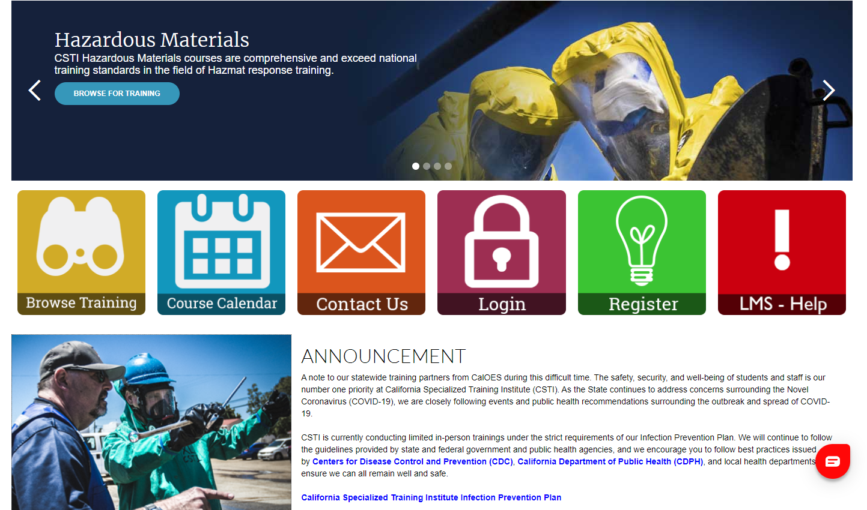
For G-606 you will need to register with
https://csti-ca.csod.com/
You will need your FEMA SID for this also.
California Specialized Training Institute, or CSTI, is the emergency management training section for Cal OES.

Slide 6
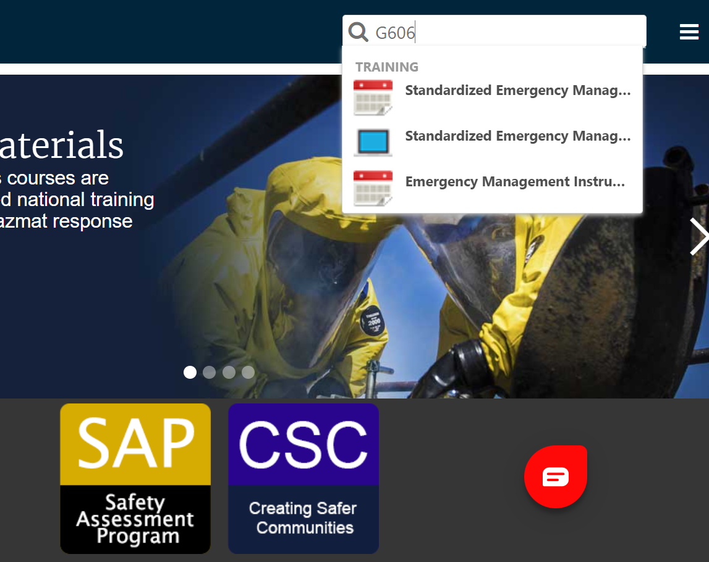
After registering use the search function (magnifying glass) on the top right corner to search “G-606”.
A list will appear click on the second choice with the screen icon.

Slide 7
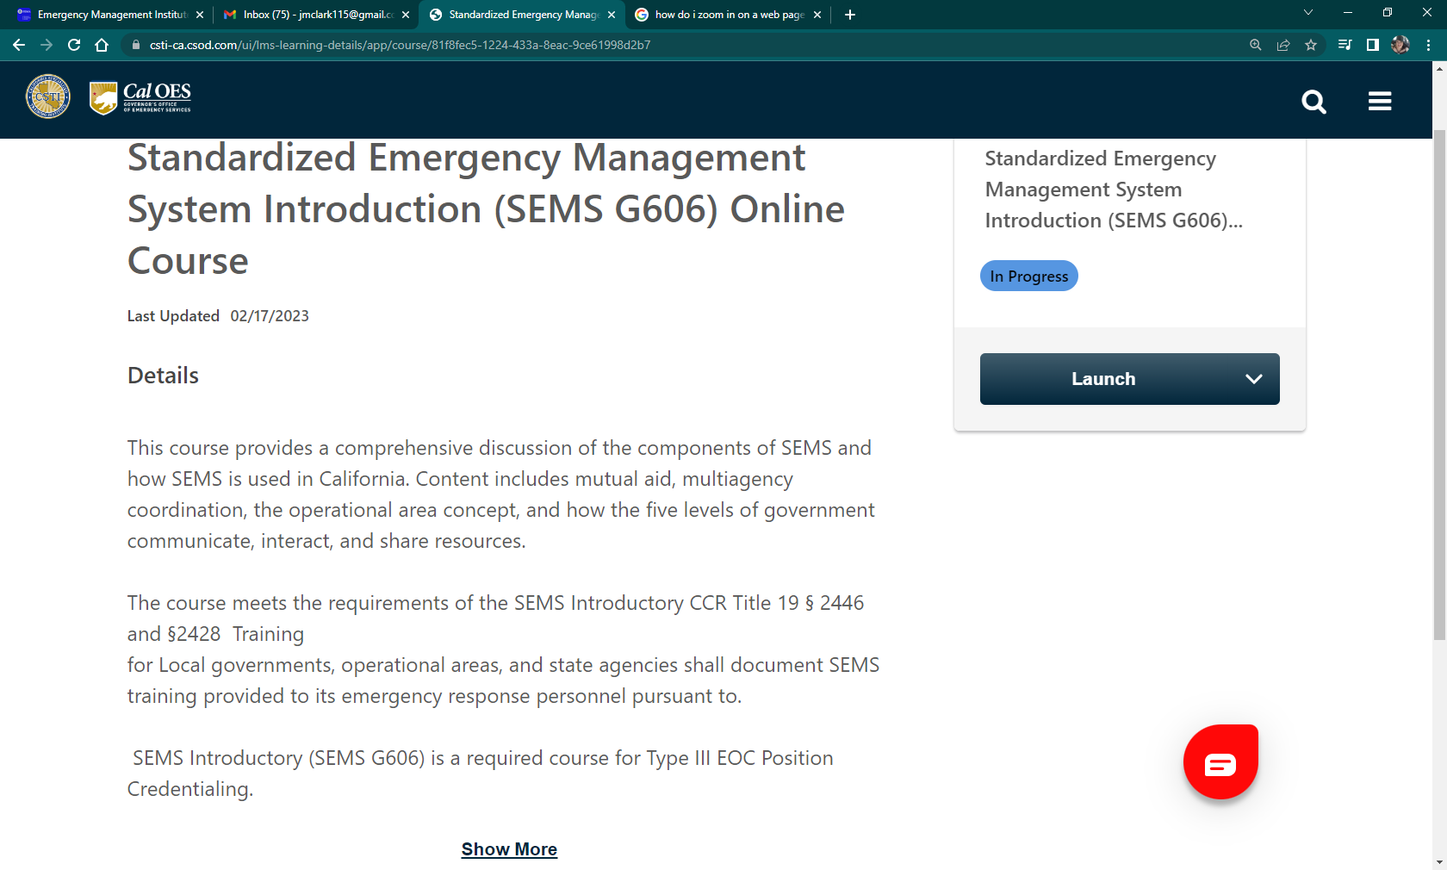
The next screen you should see will look like this. Click the “Launch” button to start the course.

Slide 8
After each training there will be a test, once the test is passed a certificate will be issued. Most courses will allow you to download a PDF for reference throughout the course.
These certificates, along the with a signed and completed ICS Training Acknowledgement Form need to be emailed as one-email with all included attachments to sjcengage@sjgov.org.

